Slide 2
Valgerður Þorbjörg Elin Guðjónsdóttir
Háskólinn á Bifröst
Project Manager – Academic Services

Slide 3
ISLAND ↔ LATVIJA
103 000 km² 64 500 km²
~330 000 ~2 Mill. Inhabitants
Density of population
2,6 inhabitants/skm ~35 inhabitants/skm

Slide 4
Iceland - figures
GDP per capita: USD 44.575 (23rd)
Capital: Reykjavík
Universities 7
  In Reykjavik
    University of Iceland
    Reykjavik University
    Iceland Academy of the Arts
  - Out of Reykjavik
    Bifröst University
    University of Akureyri
    Agricultural University of Iceland
    Holar University

Slide 5
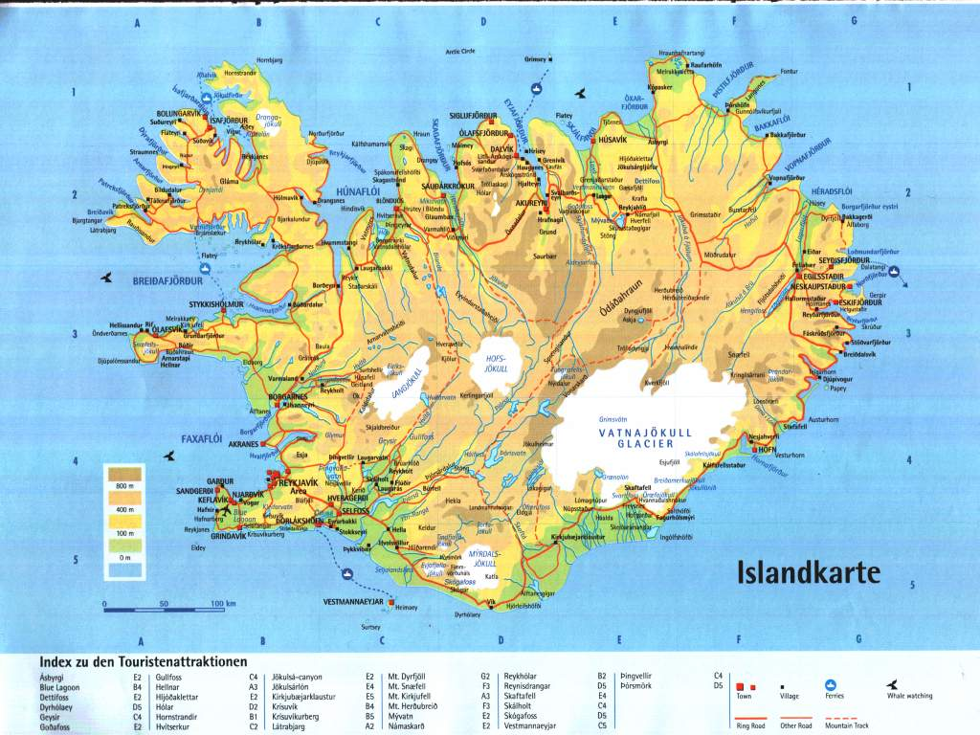
BU

Slide 6
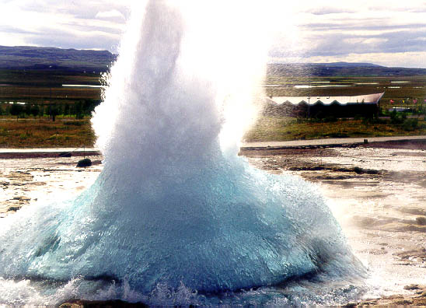
Strokkur – hot spring erupting

Slide 7
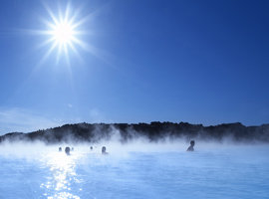
The Blue Lagoon and other warm springs

Slide 8
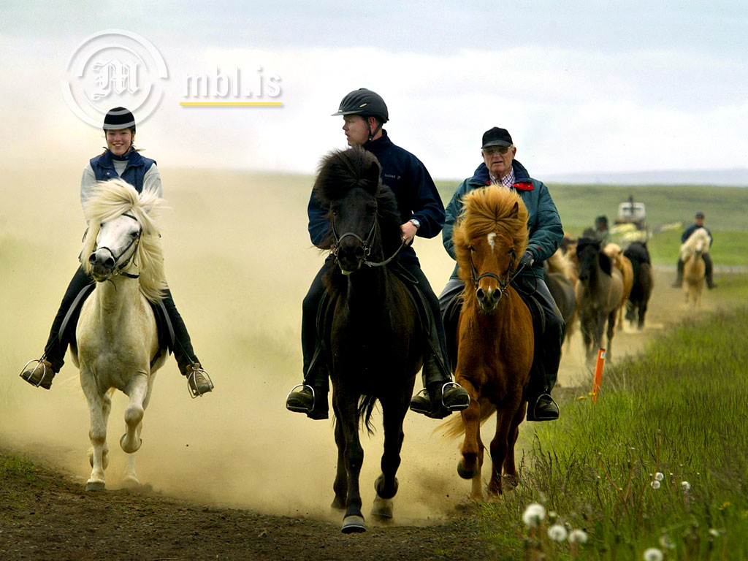
Icelandic horse – 5 gaites

Slide 9
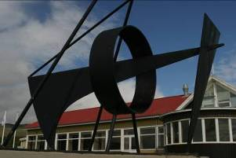
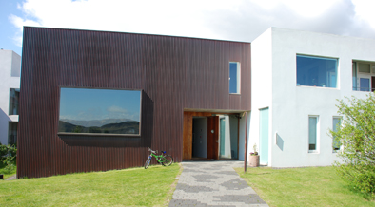
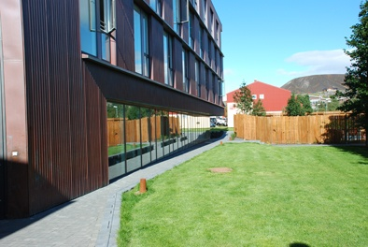
Bifröst University
Educational quality. Has educated leaders and managers within the Icelandic society for almost 100 years.
Established in 1918, based on the Ruskin College in Oxford
Private, non-profit organisation
Grown remarkably from 2000 – 2008 (* 5)
Financial crisis has hampered that growth
Only campus village in Iceland
All study lines according to Bologna process

Slide 10
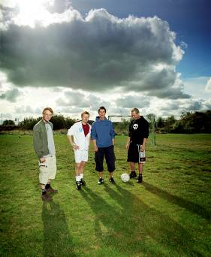
The Bifröst campus village
In the autumn of 2017: population approx. 450
Local students around 250
Distance learning (DL) students ~ 450
100 km from the capital, Reykjavík
approx. 75 min. drive
Campus
  Academic village
  Great study environment
  Good housing
  First class student facilities
  The capital area is still within easy reach
  Active social life

Slide 11
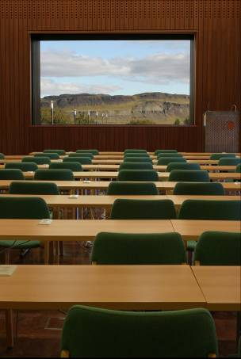
Faculties and student services
Preparatory programme (1 year)
Faculty of Business
Faculty of Law
Faculty of Social Scienses
3 year degree programmes
– can be earned in 2,5 yrs. - Summer term
- interdisciplinary
Summer School programs for foreign students
Comprehensive Lifelong Learning Programmes

Slide 12
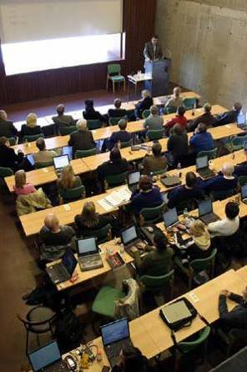
Faculty of Business
BS in Business Administration (Local and DL)
BS in Marketing Communications (DL)
BS in Business of Tourism (DL)
Leadership programme built on a broad foundation
2,5 – 3 year programme
Three main lines with multiple selection

Slide 13

Faculty of Law
BS in Business Law
A combination of finance and business law
A 2,5 year degree
First students graduated in 2004

Slide 14
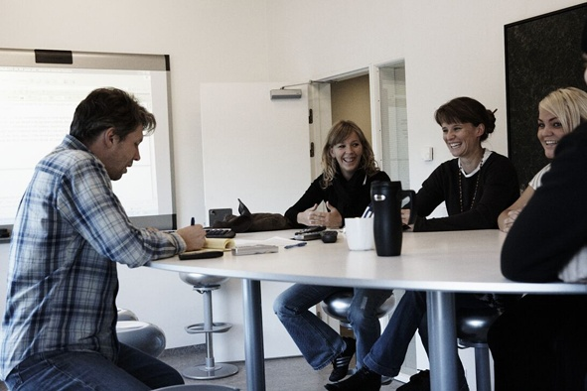
Faculty of Social Scienses
BA in PPE
Combination of Philosophy, Politics and Economics (PPE)
2,5 year degree
Based on a model from Oxford University.
Taught in Icelandic and some courses in English

Slide 15
Research: Institute and centres
The Bifröst University Research Center
  Undertakes projects for economy and society
  Assists the university‘s academic staff
Five independent Research Centres
  Centre for European Studies
  Centre for Research in Labour Law and Gender Equality
  Centre for Cultural Research
  Centre for Management and International Business
  Centre for Retail Studies

Slide 16
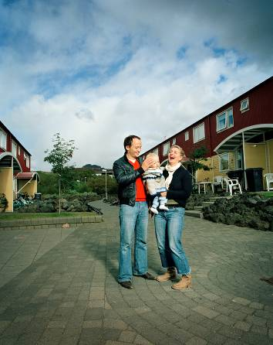
Masters programmes
Faculty of Business
  MS/MIB International Business
  MS in Leadership and Management
Faculty of Law
  ML and MBL (new) in Law
Faculty of Social Scienses
  MA – in Cultural Management
  MA – in International Political Economy
  MCM – in Cultural Management

Slide 17
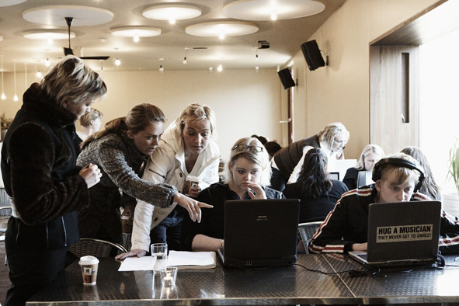
Lectures and Seminars
Realistic assignments related to real life scenarios and companies, partially problem based learning
Term projects, final assignments, final exams
Oral term projects
A lot of co-operation
The most important leadership quality is
considered to being able to work with others:
-emphasis on:
      Group work
      Communication
      Initiative
      Leadership qualities
Lectures and written exams are delivered electronically
and the campus is all linked via wireless network.
Many of the best Business Universities use similar teaching methods.

Slide 18

International Co-operation
A large % of students take a semester abroad
Visiting lecturers from partner Universities and others
  Europe
  Austria
  Belgium
  Estonia
  Finland
  France
  Greece
  The Netherlands
  Ireland
  Italy
  Lithuania
  Malta
  Poland
  Slovenia
  Spain
  Switzerland
  Sweden
  Check Republic
  Turkey
  Hungary
  Germany
  Denmark
  Asía
  Japan
  China
  Singapore
  South Korea
  - Malasia
  North America
  USA
  Canada
  South America
  Peru
  Mexico
  Africa
  South Africa

Slide 19
Academic Services
Organize most things when it comes to:
Rules and regulations
Student registry
Timetabling , syllabus, course descriptions etc.
Regulate program of school year, working weekends for DL, exam schedule etc.
Prepare new teachers, assist and service teachers and students.

Slide 20
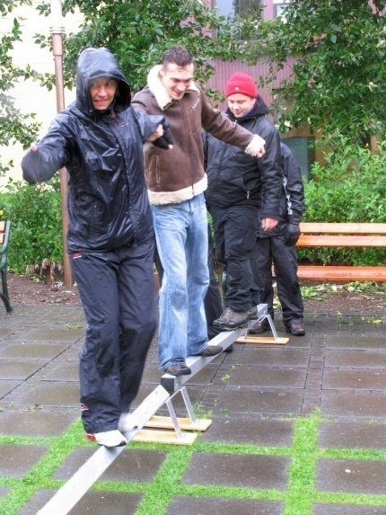
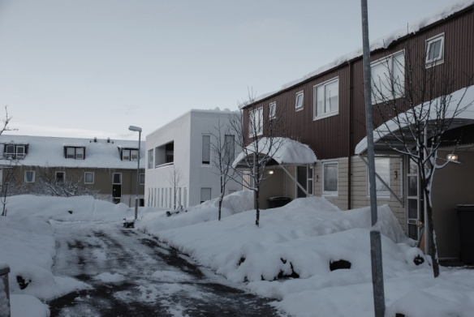
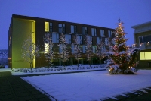
Quick facts on Bifröst
Ratio of students and faculty 1:15
  Close co-operation with lecturers and other University staff
  Groups of 10-15 students
IT
  All assignemnts and exams are electronic
  Wireless connection all over campus
70% of graduates work in middle management within 5 years of graduation
Good student services
New student accommodation
Extensive library and IT services
Shop, restaurant, café, gym, sauna
Kindergarten, primary school, football and basketball fields, golf, hiking, fishing.
Drop out rate the lowest in the country

Slide 21
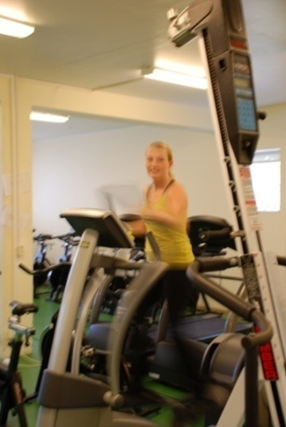
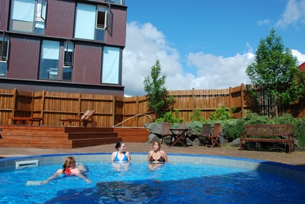
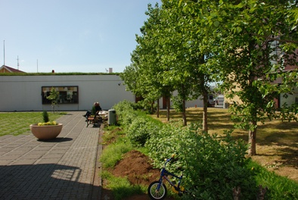
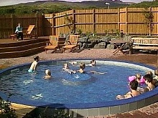
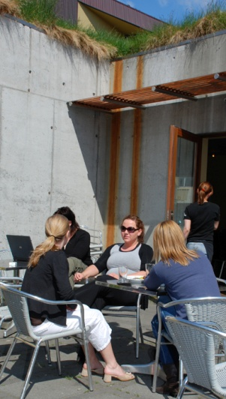
Life at Bifröst
Quality education and high level of services
- small groups, personal connections
  Gym
  gym, hot tubs, sauna
Coffee house
  Clubs: riding club, jeep club, hiking club etc.
Free Internet Connection
  good IT services

Slide 22
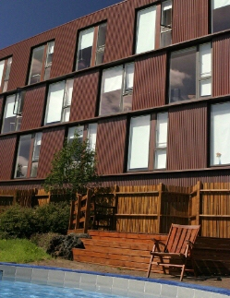
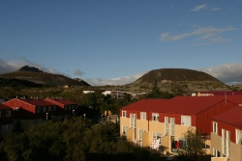
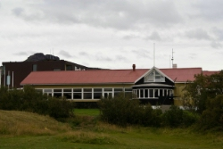
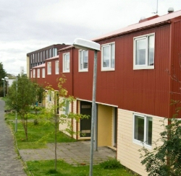
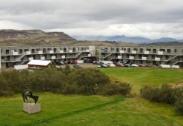
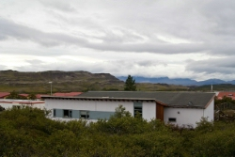
Housing for all

Slide 23
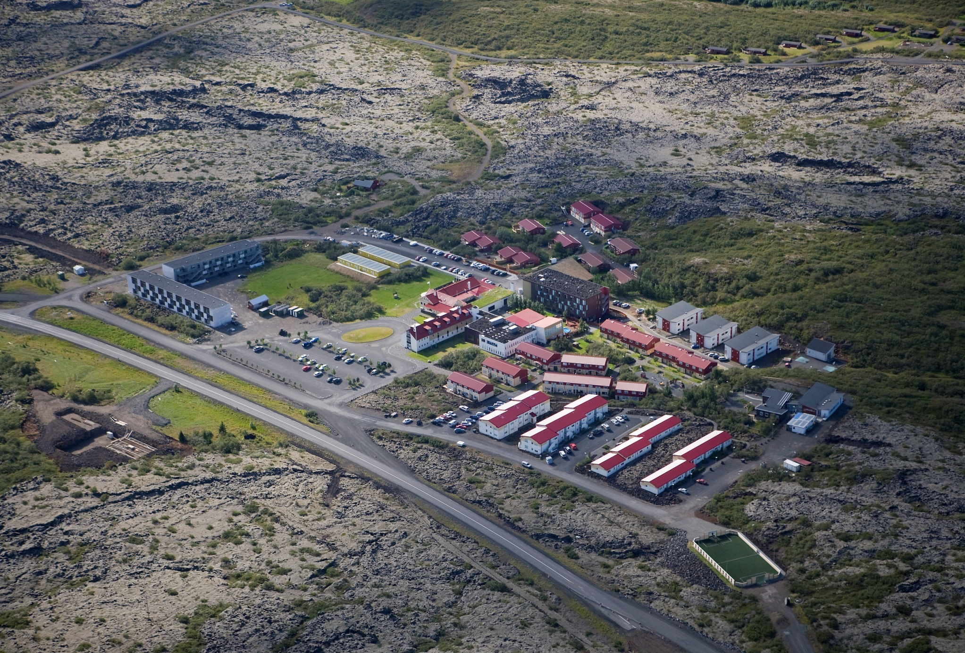

Slide 24
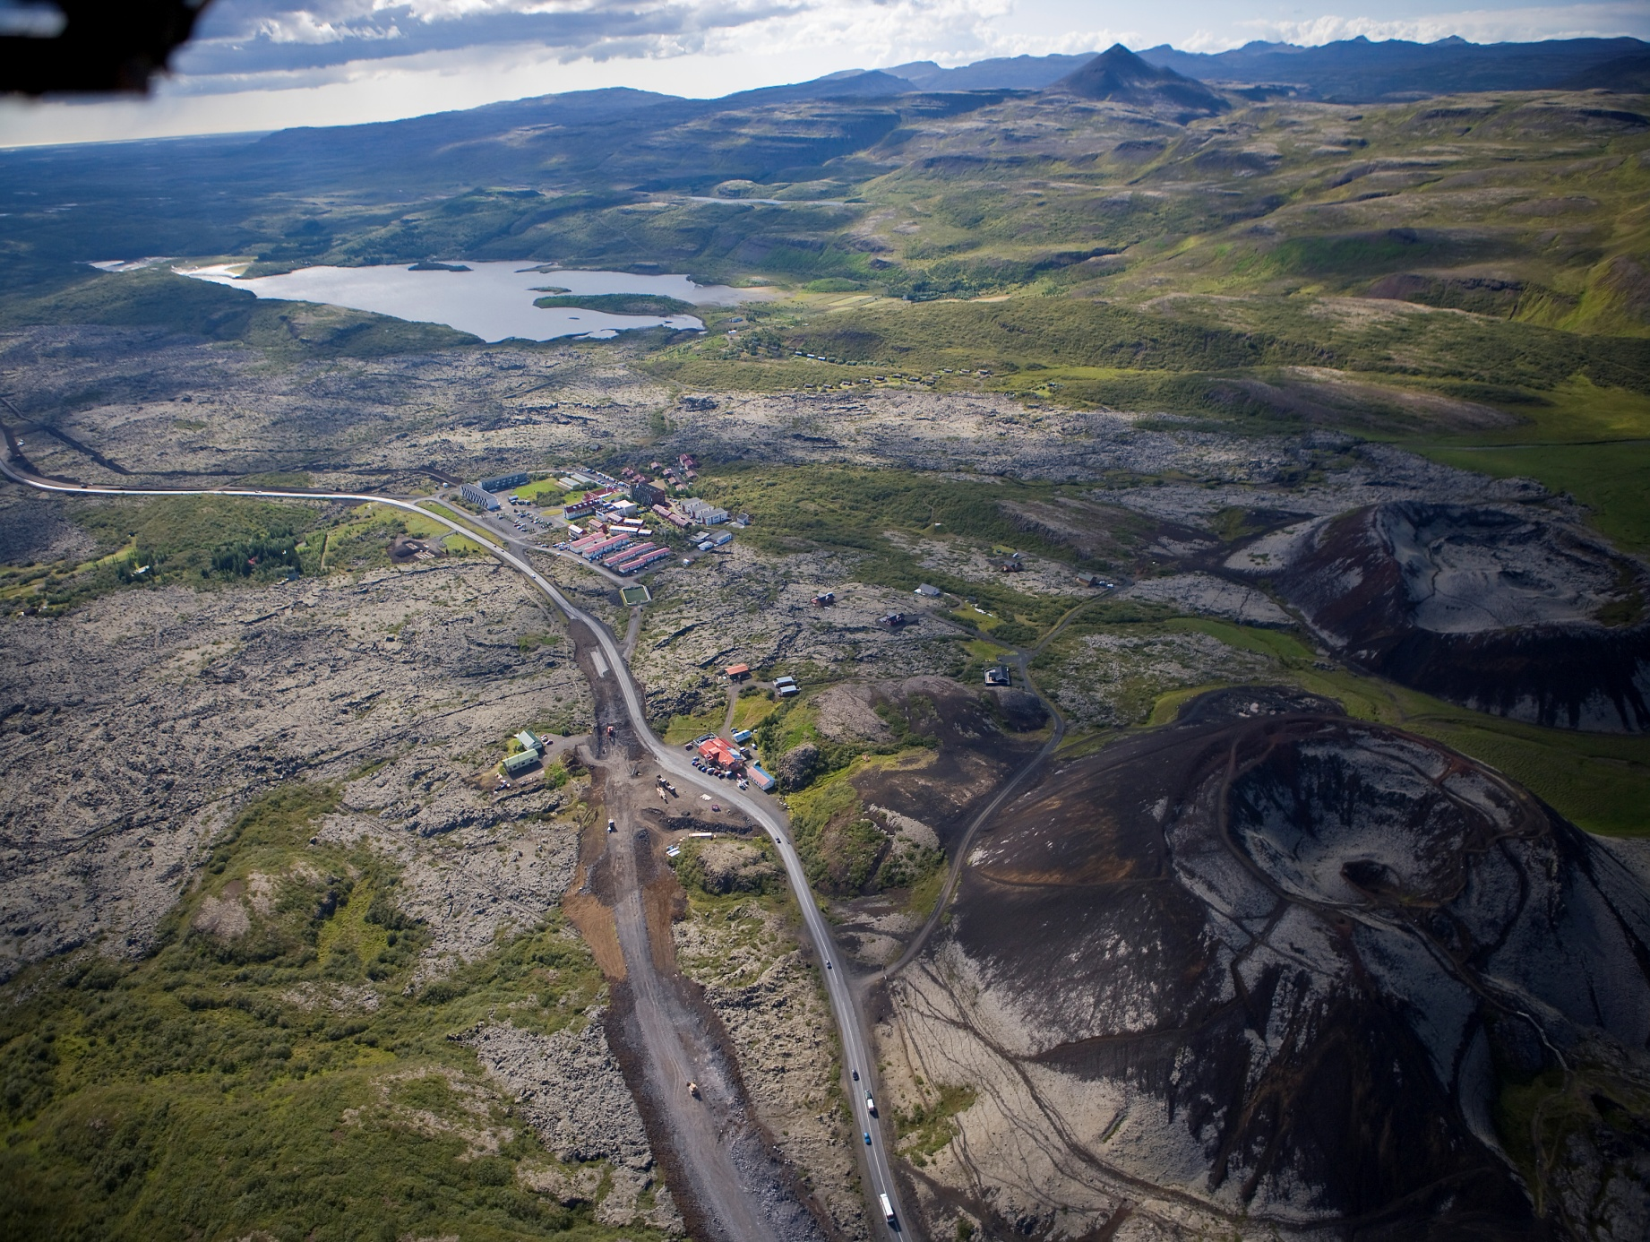

Slide 26
© Háskólinn á Bifröst 2013-14
Kennsluefni þetta er bundið höfundar og birtingarrétti samkvæmt lögum nr. 73/1972. Efnið er ætlað til einkaafnota nemenda og starfsfólks Háskólans á Bifröst. Dreifing eða birting þess með öðrum hætti er með öllu óheimil.

